Slide 1
Transit Talks: Impact of Homelessness on Transit
February 24, 2021

Slide 2
Welcome & Overview
Michael Pimentel
Executive Director
California Transit Association
Jacklyn Montgomery
Executive Director
California Association for Coordinated Transportation

Slide 3
Program
Welcome & Overview
Presentations
Q&A
Wrap-up & Adjourn
Notes:
Michael

Slide 4
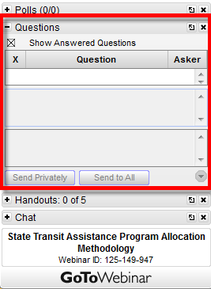
How to Ask Questions
Submit your questions anytime during the program using the Questions module in your webinar control panel at the right of your screen.
Notes:
Michael
*I will now turn things over to Josh Shaw.

Slide 5
Presenters
Anastasia Loukaitou-Sideris Distinguished Professor of Urban Planning UCLA Luskin School of Public Affairs University of California Institute of Transportation Studies
Jacob Wasserman Research Project Manager University of California Institute of Transportation Studies
Notes:
Mary Buchanan, senior research associate at TransitCenter
At TransitCenter, she explores rider-focused practices and measures that make transit more equitable and more functional in U.S. cities. In this role, Mary is developing recommendations for transit agencies to advance equitable systems, beyond federal regulations. Some of her other work includes using real-time data to advocate for better service and evaluating programs to improve bus stops. Mary holds a B.A. in Economics from Rice University and a Masters in City and Regional Planning from Rutgers University.

Slide 6
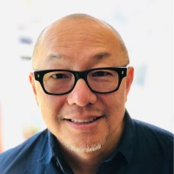
Presenter
Tim Chan Group Manager – Stations Planning San Francisco Bay Area Rapid Transit District
Notes:
Tim’s Bio
Tim Chan has 22 years of planning experience. He has a Bachelors in Rhetoric at UC Berkeley and a Masters in Urban Planning at UCLA. He is currently the Group Manager of Station Area Planning at BART where his team leads and supports the District’s policies, programs and projects in the areas of land use/TOD, multi-modal access, station modernization, placemaking/urban design, customer experience and sustainability. He also leads the District’s Quality of Life/Homeless Programs where he develops strategies, partnerships, and initiatives to address customer concerns while also helping those experiencing homelessness in the BART system find services.

Slide 7
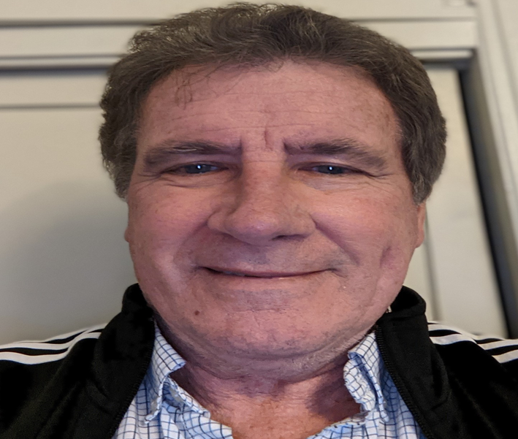
Presenter
Mark Shaffer Director UCP Ride-On Transportation
Notes:
Mark Shaffer

Slide 8
Q&A

Slide 9
How to Ask Questions
Submit your questions anytime during the program using the Questions module in your webinar control panel at the right of your screen.
Notes:
Michael
*I will now turn things over to Josh Shaw.

Slide 10
Wrap-up & Adjourn
Michael Pimentel
Executive Director
California Transit Association
Jacklyn Montgomery
Executive Director
California Association for Coordinated Transportation

Slide 11
Transit Talks: Impact of Homelessness on Transit
February 24, 2021

