Slide 1
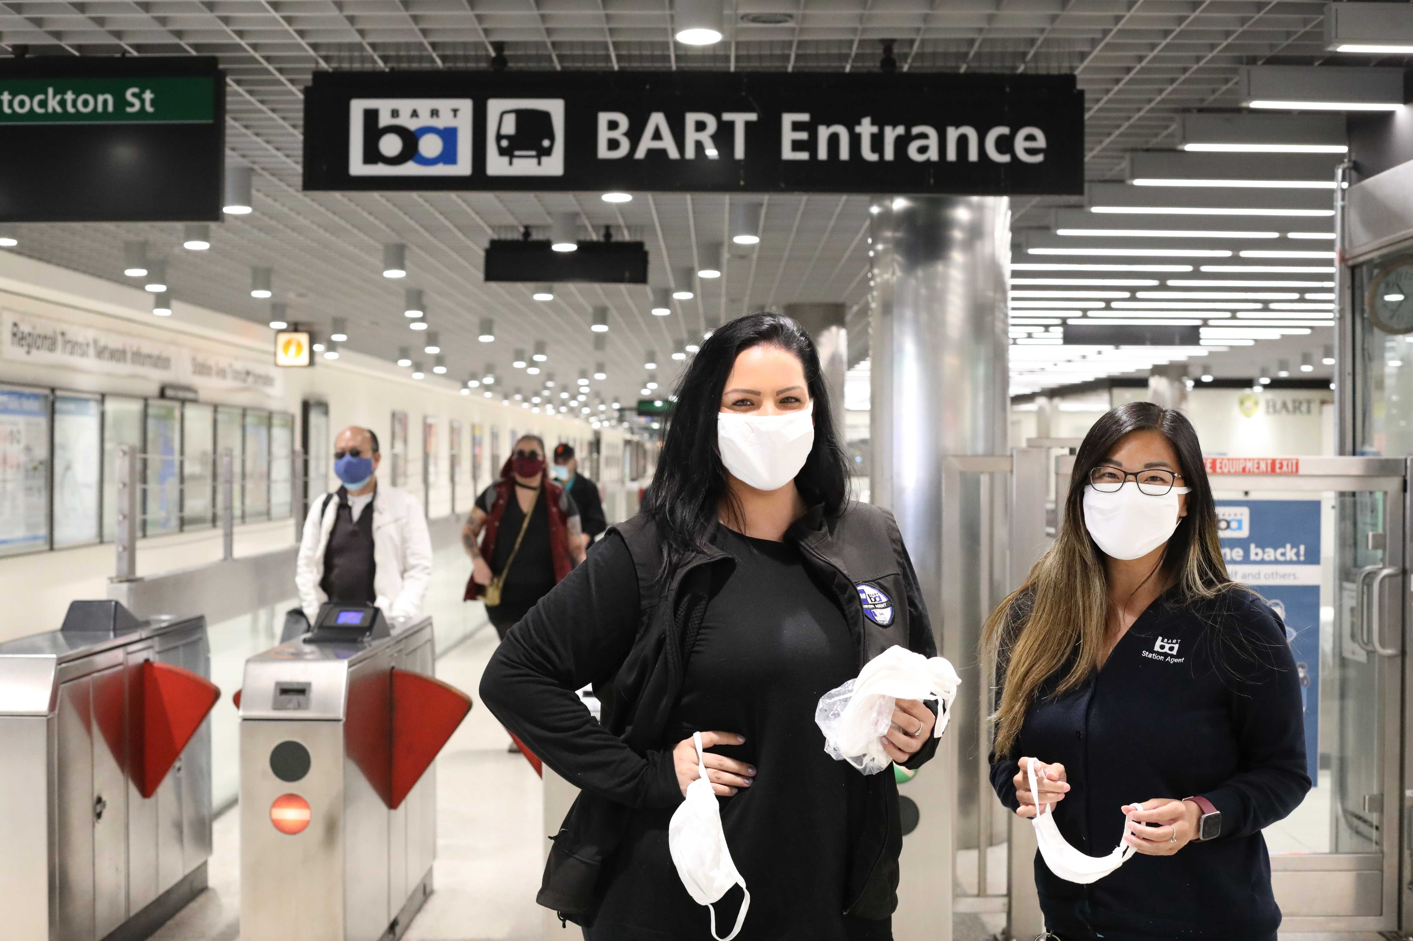
Transit Talk: Homelessness
February 24, 2021

Slide 2
Presentation Overview
BART System
A Region in Crisis During the Pandemic
Homeless Counts in Stations and on Trains
Challenges to BART
Quality of Life/Homeless Programs
Notes:
Good afternoon everyone, my presentation will first give you some background info about BART, then provide context about what’s going on in the Bay Area during the pandemic, how BART has been tracking the unhoused population in our system, the challenges that they pose to BART and how we’ve responded to these challenges.

Slide 3
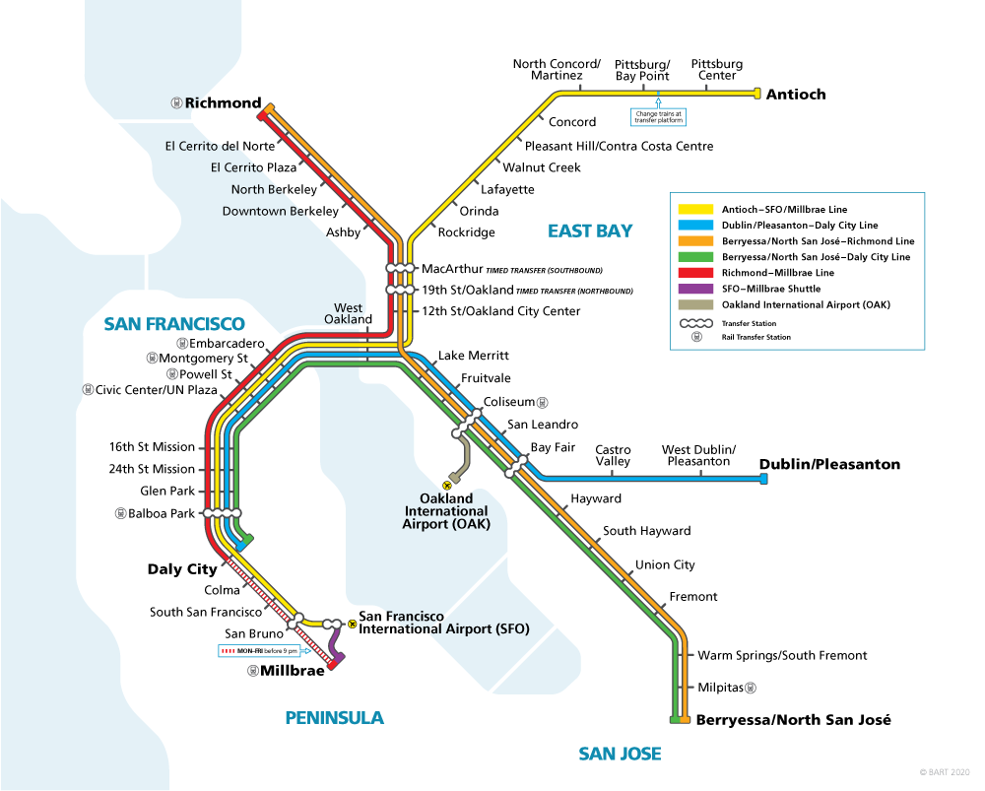
BART System
5 Counties
Alameda
Contra Costa
San Francisco
San Mateo
Santa Clara (VTA)
50 Stations
131 Track Miles
Ridership
416K Pre-Covid
46K - FY21 Q1

Slide 4
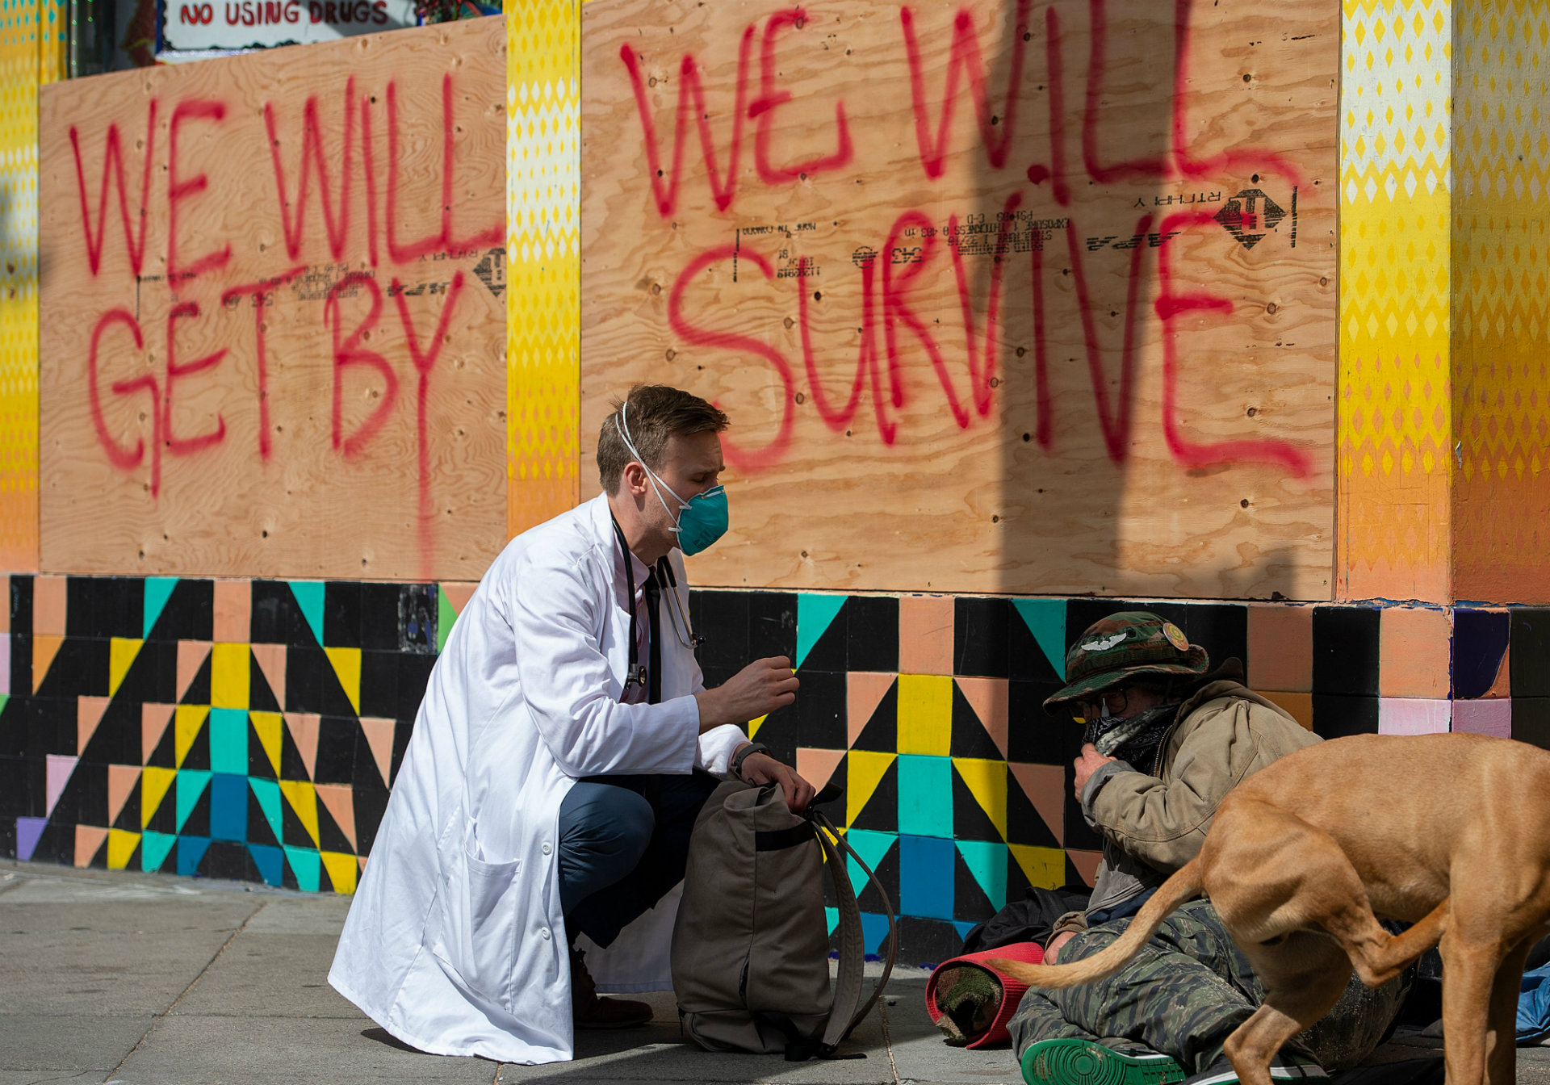
A Region in Crisis During the Pandemic
Impacts in the nine-county Bay Area
35K unhoused
Many on the verge of becoming homeless due to impacts from pandemic
Extremely low income (ELI) & Black Indigenous People of Color (BIPOC) disproportionately affected
~ $2B spent on healthcare, criminal justice & social services in Santa Clara County
Expected reduced tax revenues that may lead to less services & financial assistance
Shelters closed during pandemic with many in hotel rooms & even more on public properties
State, counties and cities are prioritizing housing for unhoused and keeping people in homes
Unclear how much funding for services, outreach, programs, treatment are available
Notes:
Homelessness has been on the rise for many years and has only worsened under the pandemic. In April 2019, the Bay Area Council report on homelessness estimated over 28K while recent numbers are closer to 35K. Alarmingly, many more are on the verge of becoming unhoused due to the pandemic, further disproportionately affecting the extremely low income and racial minorities. There are significant regional and local economic impacts with billions spent to address the many aspects of homelessness, and anticipated, reduced tax revenue may lead to less financial assistance and services to help those with the greatest needs. The shelters have been closed during the pandemic with many in hotel rooms or public spaces. The State, counties and cities are prioritizing getting people housed and keeping people in their homes, but at the same time, it is unclear how much funding is leftover for services, outreach, and treatment.

Slide 5
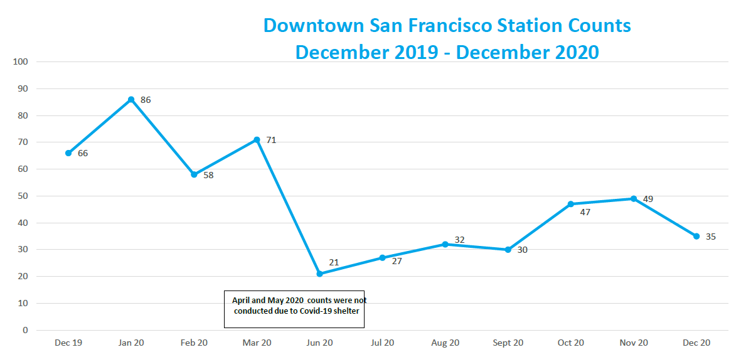
Homeless Counts in Stations
Frontline Employee Safety & Customer Service Initiative of BART – January 25, 2021 | Page 4
Notes:
The rise of homelessness nationally is especially evident in CA where we have about ¼ of the country’s unhoused population. As the state, region, counties and cities all struggled to respond to this surge, transit operators experienced a corresponding rise on their vehicles, in the stations, at the bus stops, and around other transit facilities. BART started tracking the number of unhoused in our downtown SF stations where the problem was most acute. This slide shows the trend when the numbers were at their highest in 2019 and through the implementation of enforcement strategies, we’ve been able to reduce the numbers.

Slide 6
Homeless Counts on Trains
 | Weekday | Weekend | Total (Avg)
Transients per 100 cars
FY19 Q1 | 46 | 93 | 60
FY19 Q2 | 66 | 160 | 93
FY19 Q3 | 104 | 292 | 160
FY19 Q4 | 64 | 160 | 91
FY20 Q1 | 89 | 166 | 111
FY20 Q2 | 57 | 109 | 73
FY20 Q3 | 72 | 105 | 82
FY20 Q4 | No Data | No Data | No Data
FY21 Q1 | 50 | 69 | 56
FY21 Q2 | 38 | 53 | 42
Notes:
During the same period, we also saw a sharp increase in the number of unhoused people on our trains. Many ride BART all day long, exit the system at the end of the night and return first thing when we open. As with the stations, the numbers were at their highest in 2019, but BART strategies to increase safety and security presence on our trains has helped reduce their numbers.

Slide 7
Challenges to BART
Challenges to BART
Property Damage
Cleanliness
Safety & Security
Financial
Lost Ridership
Lack of/ limited partnerships
Notes:
BART participated in UCLA’s study, and we shared many of the same outcomes reported by other transit operators. As you saw in the previous two slides, homelessness has created difficult and ongoing challenges in our trains and at our stations around safety & security and cleanliness issues. Encampments also pose huge threats to our critical infrastructure as encampment explosions and fires have resulted in major property and infrastructure damage and service disruptions.
Responding to these challenges has taken considerable financial resources that we don’t have. Unfortunately, there has been no transit assistance at the state level and some assistance at the local level. This means we have to rely mostly on our operating revenues to make things happen. During the pandemic with only a fraction of our normal farebox revenue, we have to make difficult decisions about what we defer in order to fund our quality of life/homeless programs. However, we continue to prioritize our responses to homelessness in our system as riders have made it clear they won’t return to BART until they feel it is safe to do so.

Slide 8
Quality of Life/Homeless Programs
Elevator Attendants
Homeless Outreach
Station Hardening
Progressive Policing
Progressive Policing
Station Hardening
Pit Stop
Station Hardening
System Service
Notes:
To address these challenges, BART has developed a series of tailored strategies based on location and unique situations. In a 3-year span, we have created and delivered quality of life/homeless programs that include station hardening, homeless outreach, cleanliness, elevator attendants, attended restrooms, and progressive policing. For this presentation, I will highlight our work on homeless outreach and, progressive policing.
From my earlier slide, BART serves multiple counties, and without a regional body to oversee and coordinate, we have to develop separate partnerships with each county. Since 2018, BART has partnered with two counties to bring outreach workers into our stations and to connect the unhoused to services. Overall, both partnerships have been successful as hundreds of people have been connected since 2018. However, these partnerships are fragile and inconsistent. In 2020, One of the two county couldn’t afford to cost share when the pandemic hit, so we paused the HOT team partnership until things improve. Two other counties declined to partner with BART. So for now, we only partner with one county. It is a little easier when your service is in one country, but when you’ are a regional operator in multiple counties, piecing together a regional homeless outreach strategy - county by county - is difficult and time consuming.
Because of our challenges with the counties to provide adequate outreach coverage, we initiated a partnership last fall with Salvation Army. While they may not have direct connections to county services, they do offer beds and treatment for the unhoused with mental health and substance abuse issues, and having this access is important to BART.
I would also like to highlight our Progressive Policing Program. BART created this initiative to address safety & security concerns expressed by riders, and to also assist the unhoused in our system. The program comprises of non-sworn ambassadors and crisis intervention specialists, and they will be deployed throughout the system this summer. Not only is their presence designed to discourage inappropriate behavior on BART, but they will also be trained in de-escalation, mental health first aid, case management, and work with existing county programs to connect to, appropriate services. Initially, many transit agencies, including ours, were reluctant to invest in these programs, and certainly we all tried to make the case that we were transit operators and not in social services. However, it has been very clear that we must make make some level of investments in our system to respond to rider concerns and to assist the unhoused. At this time, many transit operators across the country have moved in this direction, and more continue to do so.

Slide 9
There is much more to do
Regularly engage & advocate at all levels of government
Create statewide transit advocacy coalition
Notes:
Lastly, despite our financial situation, there is so much more to do. I am going to my Board this Friday with recommendations on key action items for consideration, and I believe some of my directors may be on this webinar. I won’t list everything on this slide, but I would like to highlight my top two for this audience. First, the collective we need to step up our engagement and advocacy work at the federal, state, regional and local levels. A huge challenge for transit operators is that we get no support at the state level, and maybe at the local level if we can financially partner with county social service agencies. But what happens when we don’t have funding to do this? Or when the limited resources that we get don’t adequately address the challenges that we face?
As Gov Newsom’s budget continues to prioritize funding for housing, there is not nearly enough funding for outreach, treatment, and services, and that affects transit operators across the state. While prioritizing housing is the right call, I believe transit agencies should also be at table at all levels to help shape policies and funding strategies so we can be in the position to receive financial support and to be part of the solution in supporting the unhoused.
I have been in early communications with the California Transit Association LA Metro, Sac RTD, AC Transit, Caltrain/Samtrans, and Capitol Corridor to create a statewide transit coalition so we can advocate together with one powerful voice. Last month on January 21st , the General Managers from these agencies submitted a joint letter to the state assembly requesting more support & resources. However, we need more transit operators- large and small - to join us. If you think your agency might be interested in being part of this effort, please email me after the webinar.

Slide 10
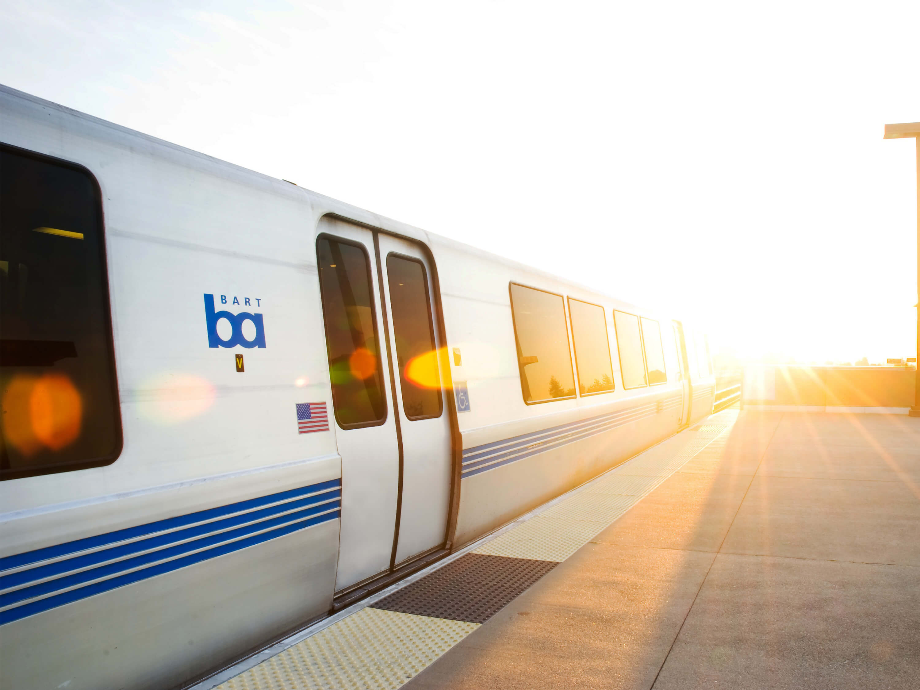
Thank You!
TChan1@bart.gov

